Slide 1

EE115 Analog and Digital Circuits
Topic 1: Introduction to Digital Fundamentals
Prof. Yajun Ha
ShanghaiTech University
Shanghai, China
This set of slides is by © Pearson Education

Slide 2
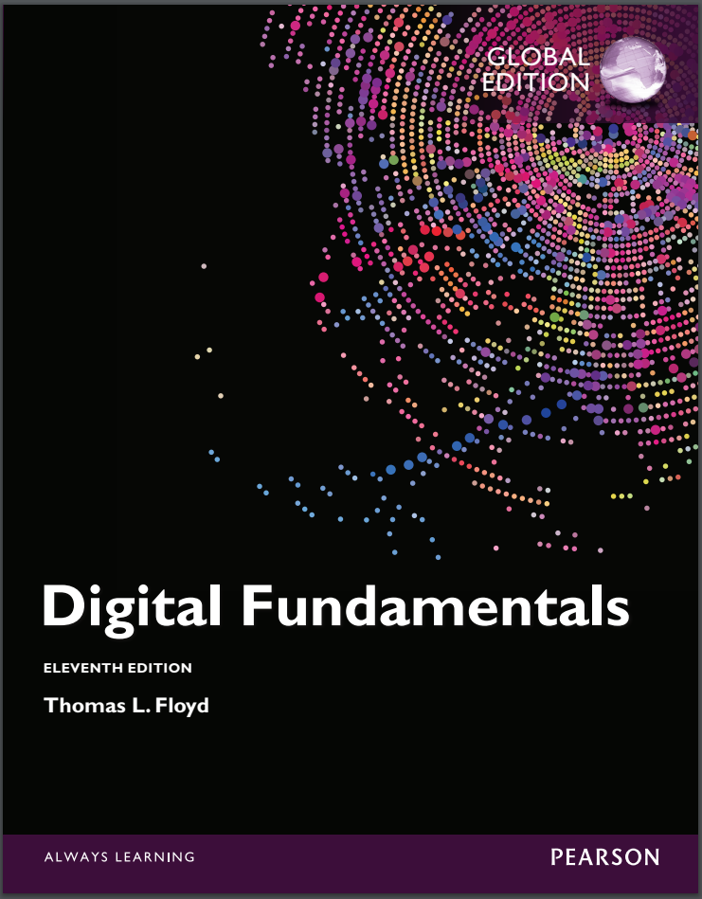
Textbook For This Course
Thomas L. Floyd,
Digital Fundamentals,
International Edition, Year: 2015, ISBN 10: 1-292-07598-8, Pearson Education Limited.
Please focus on Chapters 1-7.
Widely used textbook on the digital fundamentals related courses.

Slide 3

Introduction to Digital Fundamentals
Digital and Analog Quantities
Binary Digits, Logic Levels and Digital Waveforms
Basic Logic Functions
Combinational and Sequential Logic Functions
Programmable Logic Devices
Fixed-Function Logic Devices
Test and Measurement Instruments
Prof. Yajun Ha
Notes:
Title

Slide 4
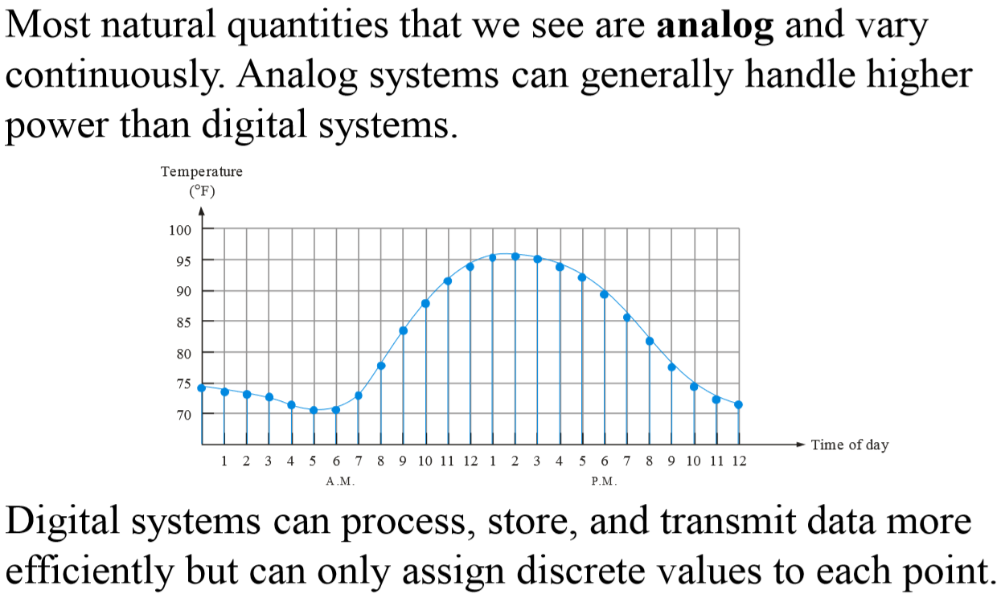
Analog Quantities
Prof. Yajun Ha
Notes:
Title

Slide 5
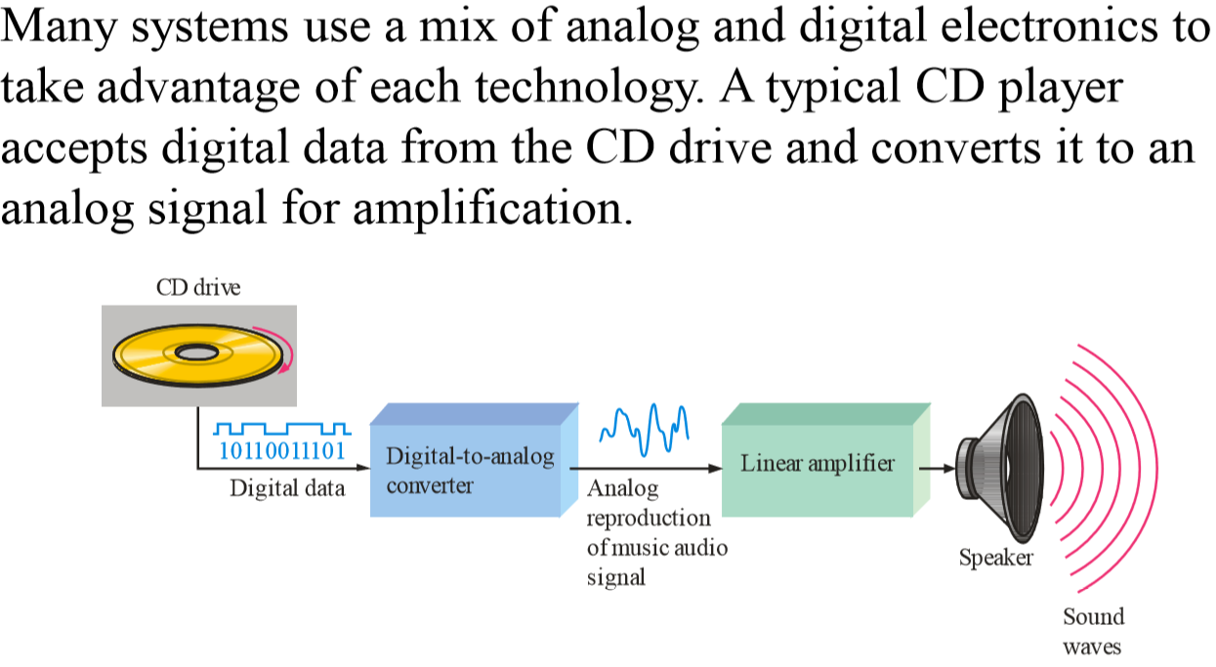
Analog and Digital Systems
Prof. Yajun Ha
Notes:
Title

Slide 6
Introduction to Digital Fundamentals
Digital and Analog Quantities
Binary Digits, Logic Levels and Digital Waveforms
Basic Logic Functions
Combinational and Sequential Logic Functions
Programmable Logic Devices
Fixed-Function Logic Devices
Test and Measurement Instruments
Prof. Yajun Ha
Notes:
Title

Slide 7
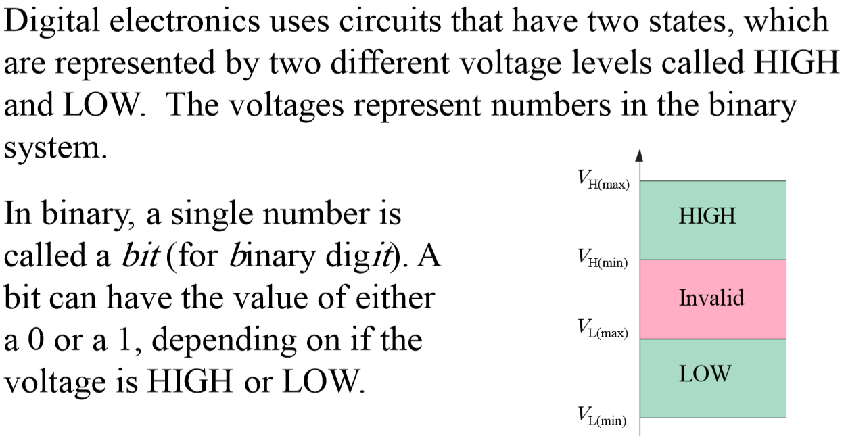
Binary Digits and Logic Levels
Prof. Yajun Ha
Notes:
Title

Slide 8
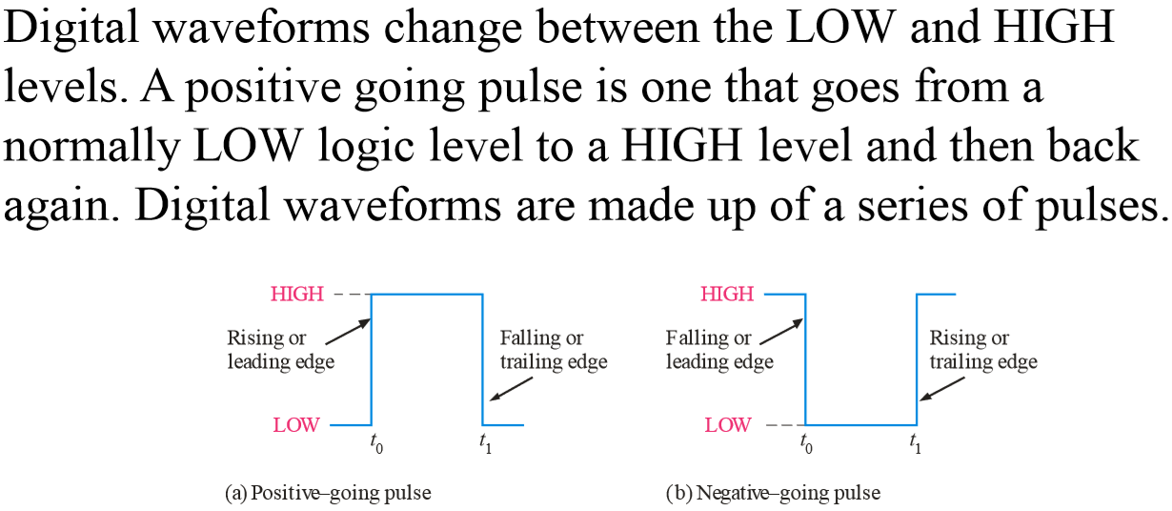
Digital Waveforms
Prof. Yajun Ha
Notes:
Title

Slide 9
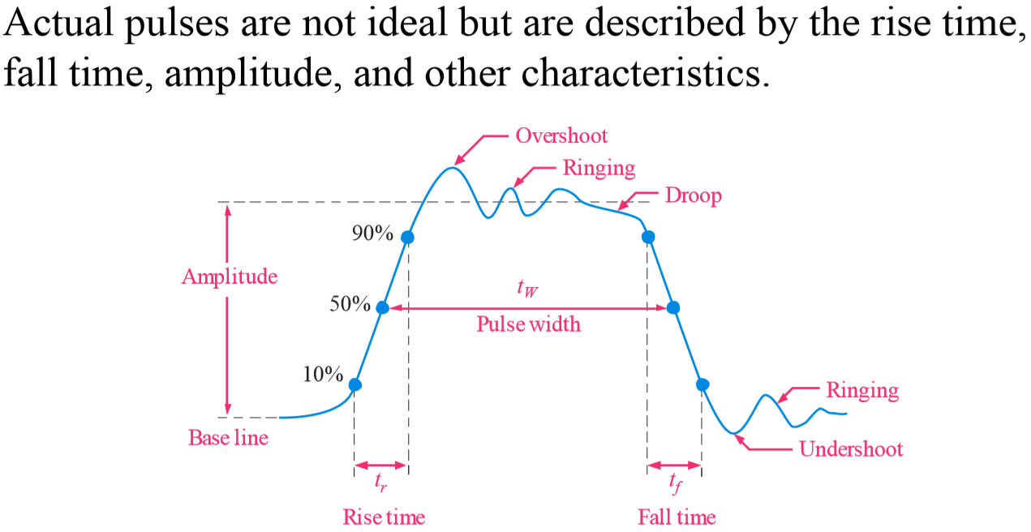
Pulse Definitions
Prof. Yajun Ha
Notes:
Title

Slide 10
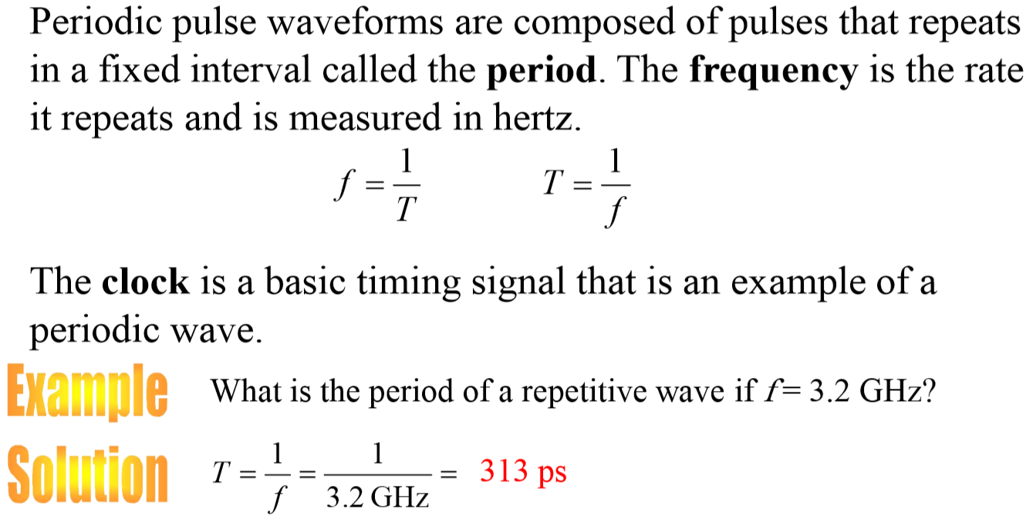
Periodic Pulse Waveforms
Notes:
Title

Slide 11
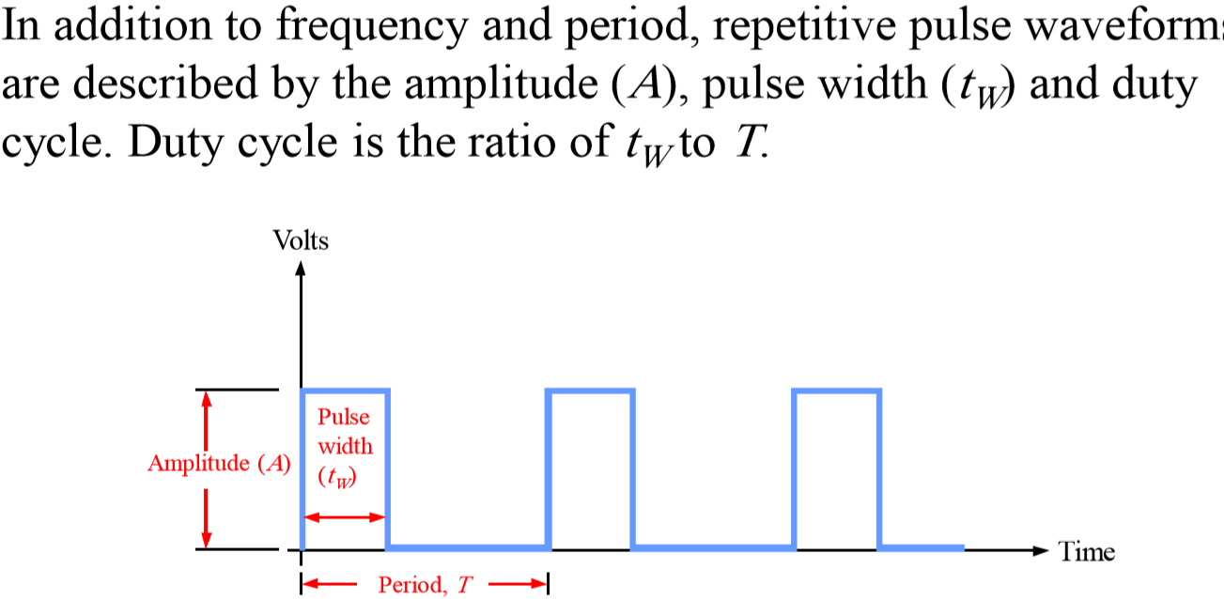
Pulse Definitions
Notes:
Title

Slide 12
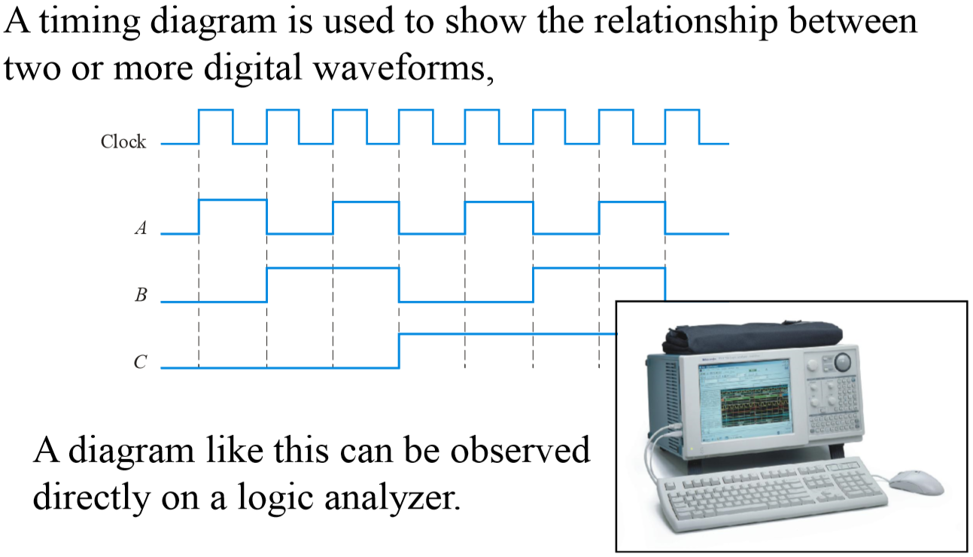
Timing Diagrams
Notes:
Title

Slide 13
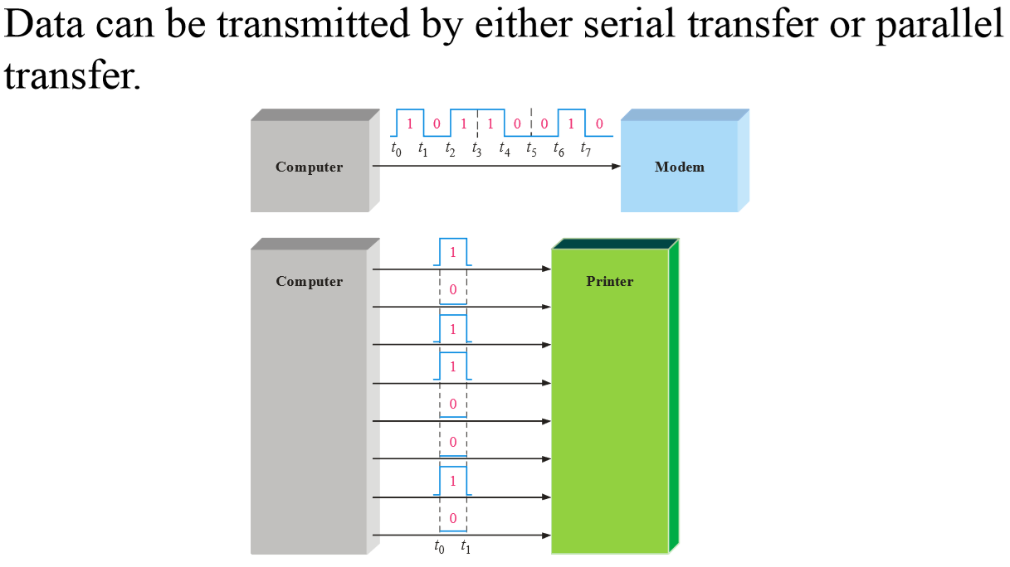
Serial and Parallel Data
Notes:
Title

Slide 14
Introduction to Digital Fundamentals
Digital and Analog Quantities
Binary Digits, Logic Levels and Digital Waveforms
Basic Logic Functions
Combinational and Sequential Logic Functions
Programmable Logic Devices
Fixed-Function Logic Devices
Test and Measurement Instruments
Prof. Yajun Ha
Notes:
Title

Slide 15
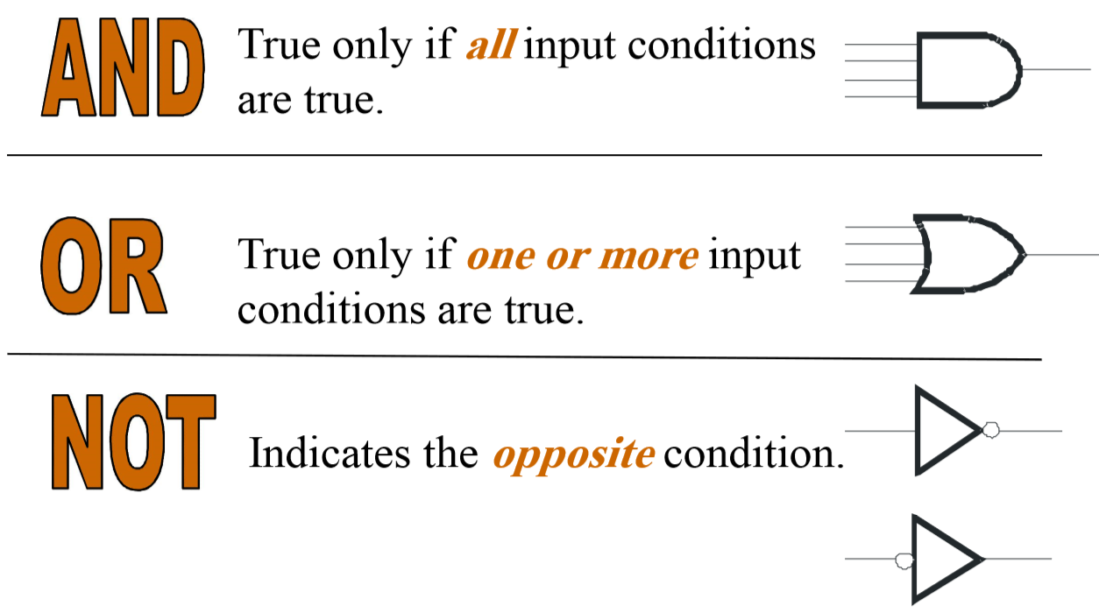
Basic Logic Functions
Notes:
Title

Slide 16
Introduction to Digital Fundamentals
Digital and Analog Quantities
Binary Digits, Logic Levels and Digital Waveforms
Basic Logic Functions
Combinational and Sequential Logic Functions
Programmable Logic Devices
Fixed-Function Logic Devices
Test and Measurement Instruments
Prof. Yajun Ha
Notes:
Title

Slide 17
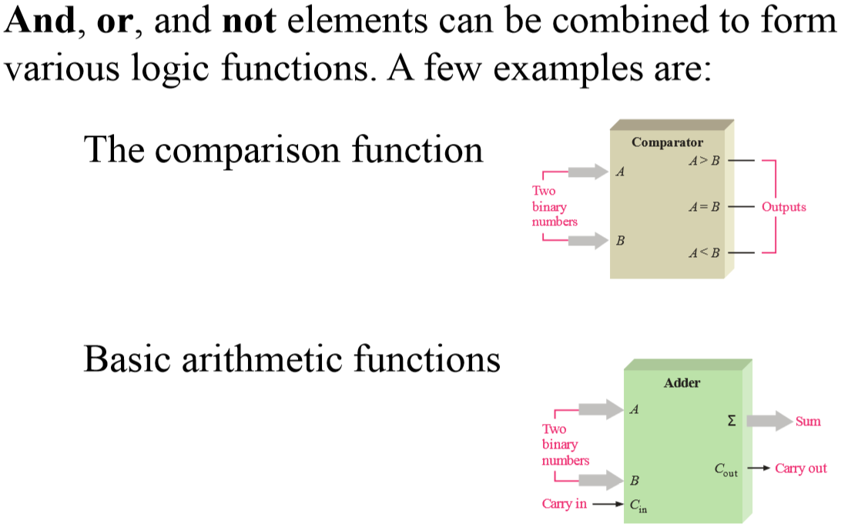
Basic System Functions
Notes:
Title

Slide 18
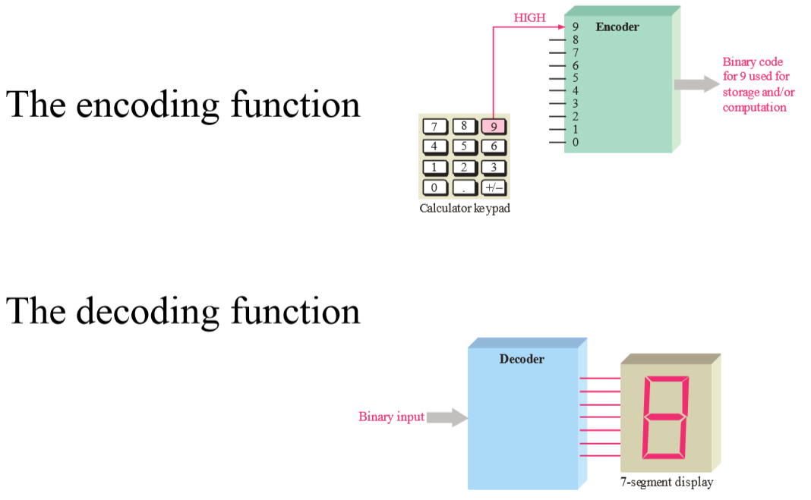
Basic System Functions
Notes:
Title

Slide 19
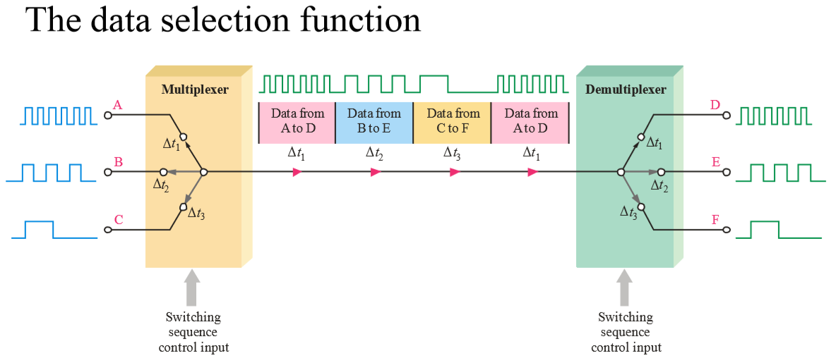
Basic System Functions
Notes:
Title

Slide 20
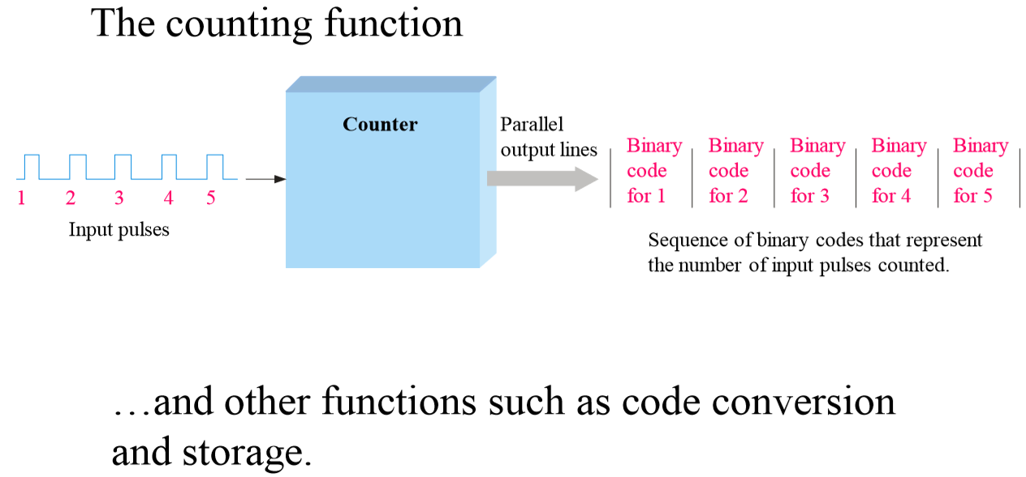
Basic System Functions
Notes:
Title

Slide 21
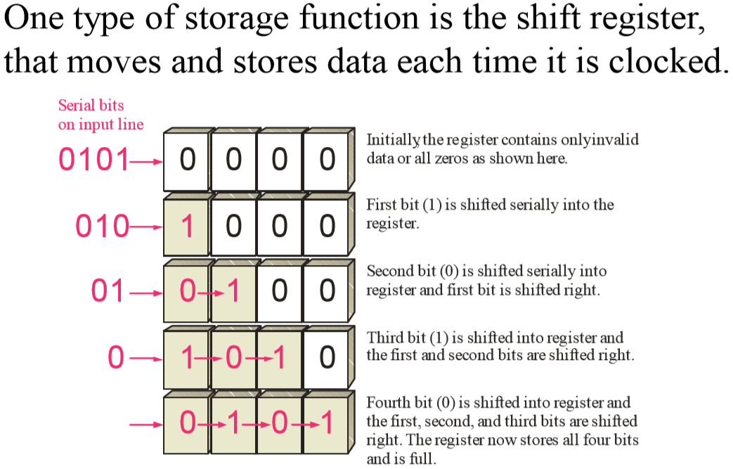
Basic System Functions
Notes:
Title

Slide 22
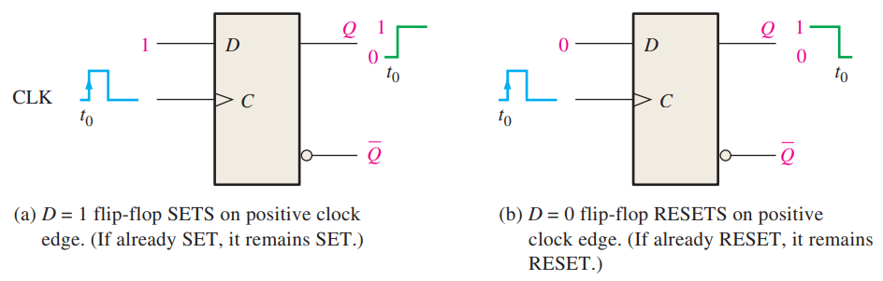
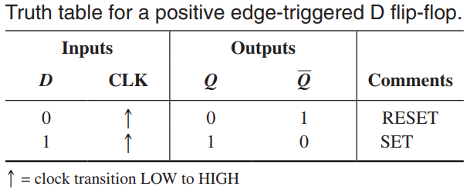
Positive Edge-Triggered D Flip-Flop
Prof. Yajun Ha

Slide 23
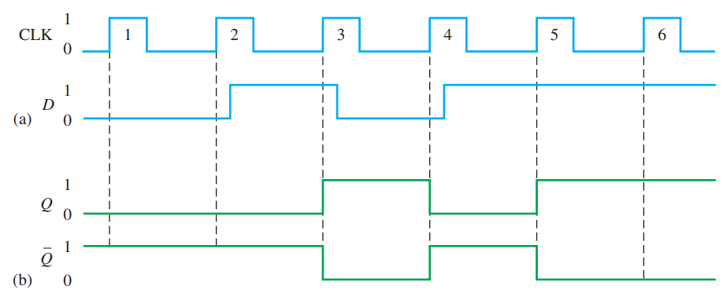
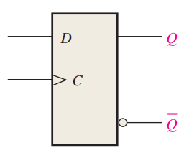
Example Waveforms of D Flip-Flop
Prof. Yajun Ha

Slide 24
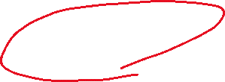
Computing with Logic Circuits
Combi Block 1
Combi Block 2
Combi Block 3
A lot of computations in an algorithm
Computations are done with combinatorial logic blocks.
Results computed by combinatorial blocks should be exchanged
How to exchange results efficiently?!
Prof. Yajun Ha

Slide 25

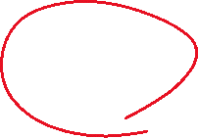




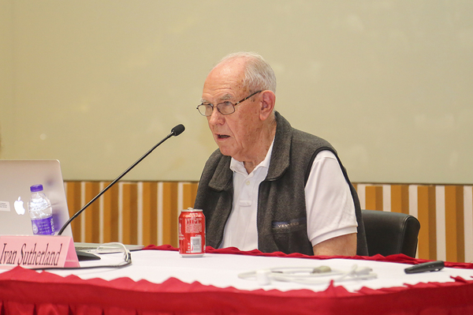
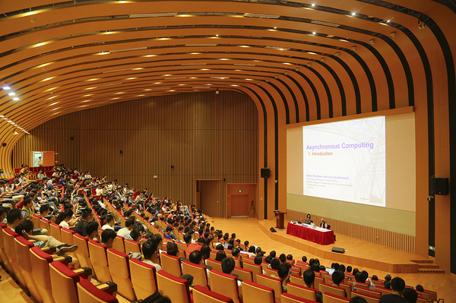
Asynchronous Circuits
Handshaking
Handshaking
Handshaking
Handshaking
Combi Block 1
Combi Block 2
Combi Block 3
Handshaking are used to exchange the results of computations in all combinatorial logic blocks.
Handshaking involves stages like requesting, acknowledging, sending…
Handshaking is only needed when there is a need for data exchange.
Prof. Yajun Ha

Slide 26
Synchronous Circuits
Combi Block 1
Combi Block 2
Combi Block 3
Clock
Clocks are used to synchronize the start of computations in all combinatorial logic blocks.
Clock period is determined by fining out the longest path delay of all combinatorial logic blocks.
All combinatorial logic blocks are supposed to finish the computations of the current clock cycle before the start of the next clock cycle.
Prof. Yajun Ha

Slide 27
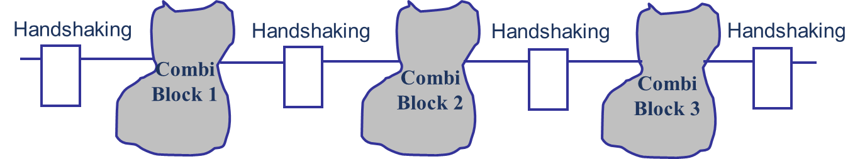
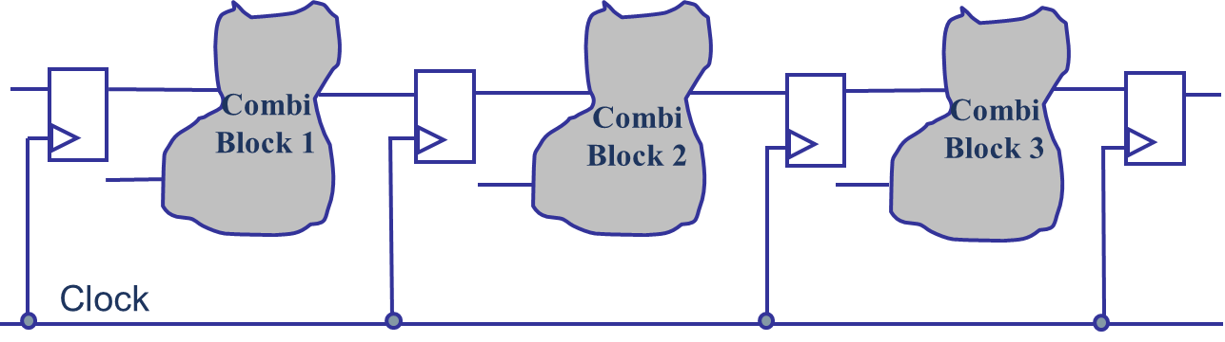
Asynchronous Versus Synchronous Circuits
Asynchronous circuits avoid the clocks, and only communicate when necessary, potentially can achieve secure, low power and scalable computing.
Synchronous circuits avoid the handshaking, and it communicates at a fixed pace, and support with EDA tools.
Current industry 99% is using synchronous approach. Who knows in the future?
Prof. Yajun Ha

